Slide 1



Smart Libraries, Smarter Assistance: Introducing RoboLib
Library Assistant Robot
RoboLib
Team SkyVision
1.Meliboev Shukurullo
2.Kiyomov Asadbek
3.Shabonov Abdulloh
4.Gofurjonov Kozimjon
December 13 , 2024
2024-1 VIP Course
Professors: Mehdi Pirahandeh, Kakani Vijay, and Serrao Pruthvi Loy Rozario

Slide 2
Contents
How It Works
Core Features
Target Audience
Technical Details
Hardware and Software Modules
Programming
Benefits

Slide 3
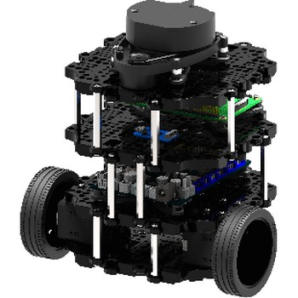
Product Overview
Our Product: RoboLib RoboLib aims to enhance library operations by automating the following tasks:
Helping users locate books.
Guiding users to library sections.
Assisting with book returns.
Answering library-related queries.
Locating multiple books efficiently.
Assisting with inventory management.
Providing library information.

Slide 4
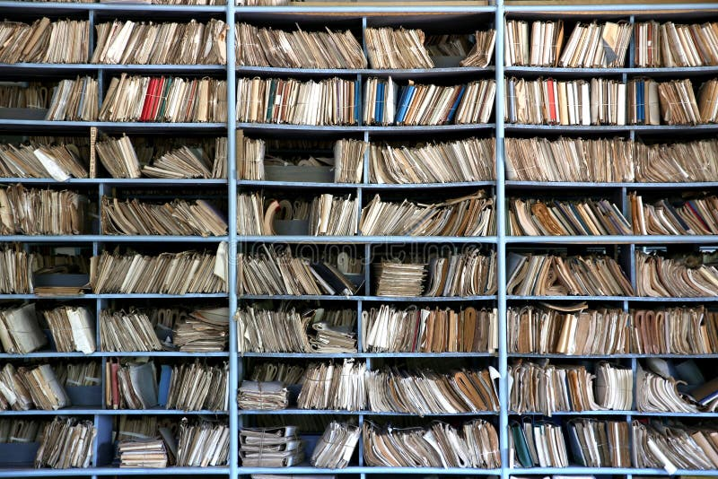
Problem Statement
Challenges in Modern Libraries:
Inefficient book location and navigation.
Time-consuming reshelving tasks.
Overburdened staff.
Manual inventory management discrepancies.
Navigational difficulties in large libraries.
Our Solution: RoboLib integrates navigation,
QR scanning, and voice interaction to:
Enhance operational efficiency.
Improve user experience.
Automate repetitive tasks, allowing staff to focus on complex duties.

Slide 5
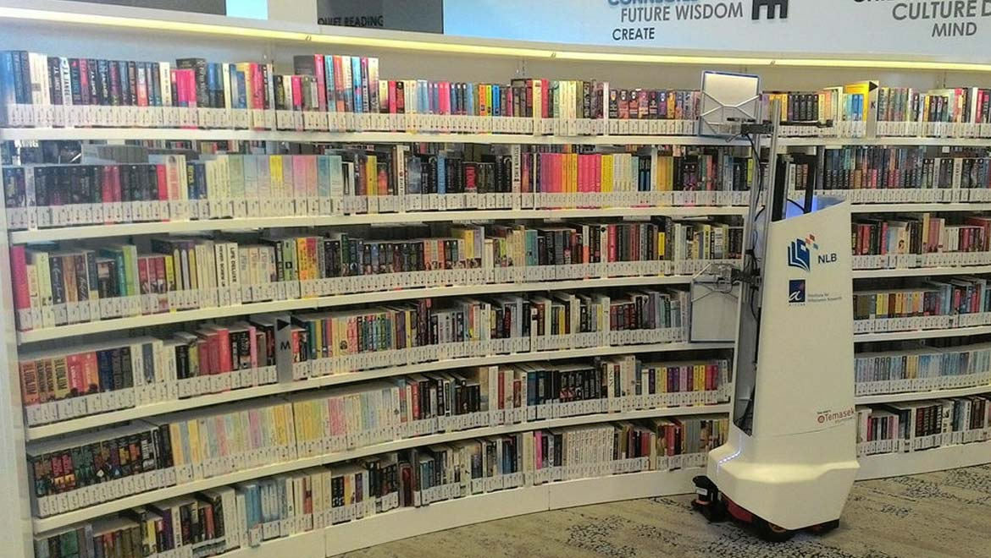
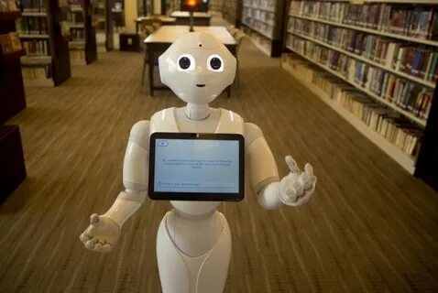
Technology Overview
Primary Technologies:
Hardware:
TurtleBot 3: Movement and obstacle detection.
LiDAR Sensor: Mapping and obstacle avoidance.
QR Scanner: Book and shelf identification.
Microphone: Voice command capture.
Software:
ROS (Robot Operating System): Core framework.
SLAM: Navigation and mapping.
Speech Recognition: User interaction.
Library Database Integration: Real-time data access.
Python: Logic and algorithm implementation.

Slide 6
Task Breakdown
Core Tasks:
Mapping the Library: SLAM creates a digital map for navigation.
Book Location Assistance: Use QR codes to find books efficiently.
Reshelving Assistance: Guides users to the correct shelf.
Inventory Checks: Automates shelf scanning for discrepancies.
User Interaction: Uses voice recognition for natural communication.

Slide 7
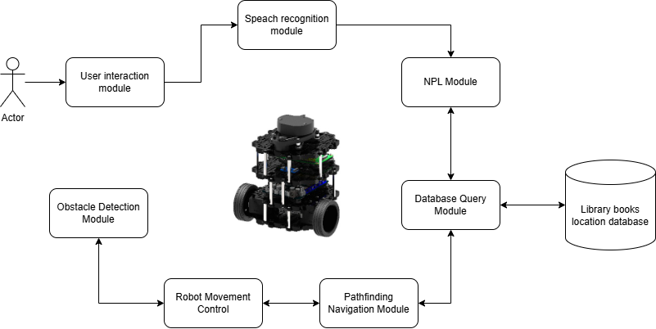
User Interaction

Slide 8
Technical Details
Hardware Setup:
TurtleBot base with LiDAR and QR Scanner.
Raspberry Pi for processing.
Software Setup:
ROS integration for real-time task management.
Python for algorithms and database interaction.
SLAM for navigation.
Google Speech-to-Text for voice commands.

Slide 9
Programming and Algorithms
Key Algorithms:
A* Algorithm:** Shortest pathfinding.
Dijkstra’s Algorithm: Optimal reshelving routes.
Dynamic Window Approach (DWA): Obstacle avoidance.
SLAM: Localization and mapping.
Natural Language Processing (NLP): Understands user queries.
Floyd-Warshall Algorithm: Multi-point navigation.

Slide 10
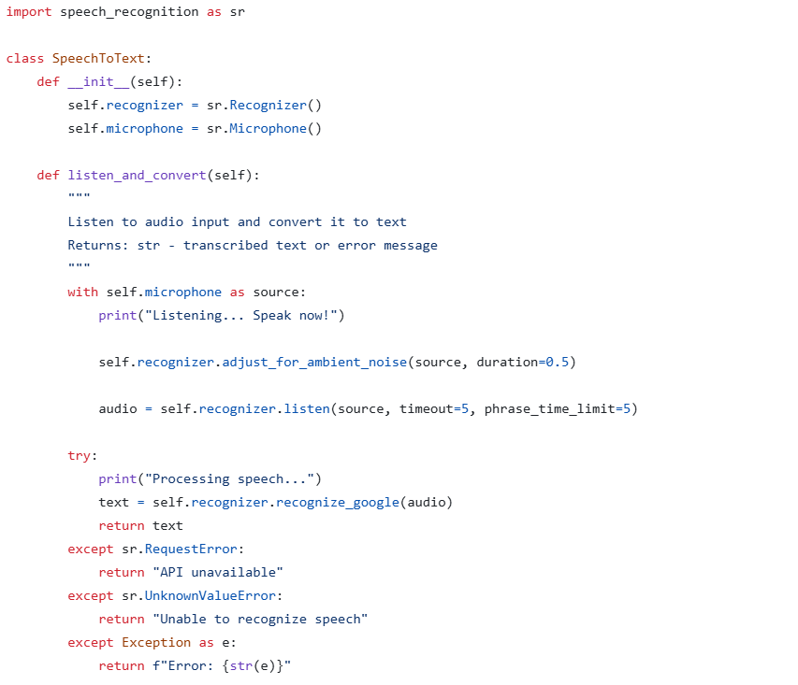
Speech to Text Algorithm

Slide 11
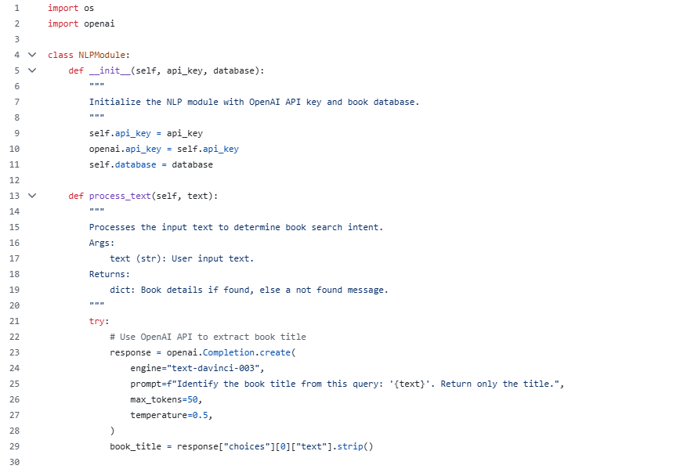
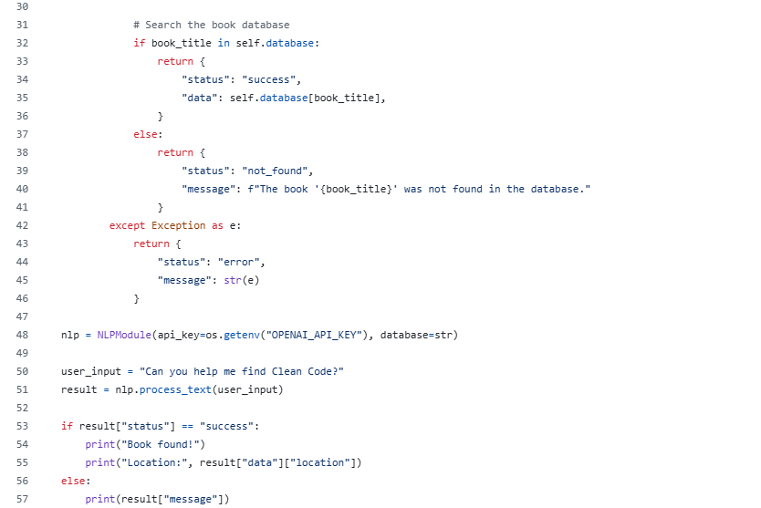
NLP Algorithm

Slide 12
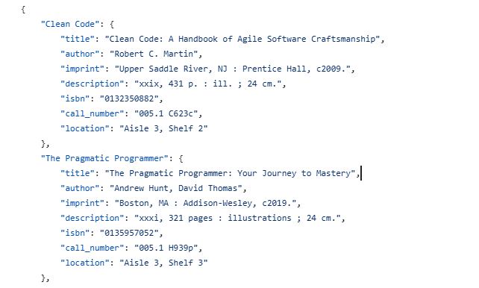
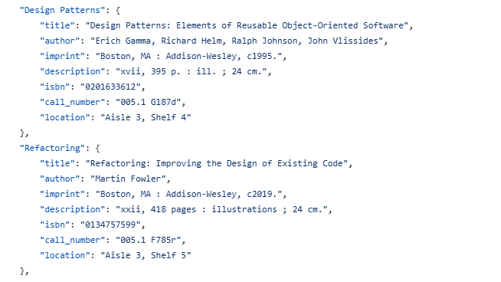
Books Database
Currently We Are Using .json File as a Database

Slide 13
Facial Expression recognition
Facial Expression Recognition:
TurtleBot3 uses cameras and facial recognition software to detect and analyze human emotions, such as happiness, sadness, or stress, through facial expressions.
Emotional Response:
Once an emotion is identified, the robot can respond accordingly, adapting its behavior to match the user's emotional state.
Book Recommendations:
Based on the detected emotion, TurtleBot3 recommends books to suit the user's mood. For example, it may suggest calming or motivational books when the user appears stressed or uplifting books when they seem happy.
Used Medipipe library of GOOGLE

Slide 14
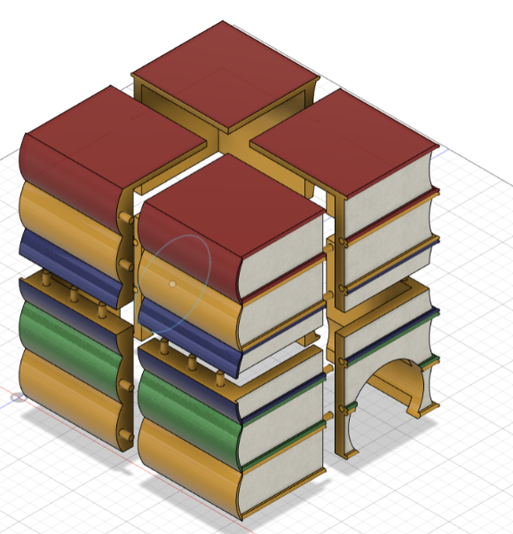
3D Model

Slide 15
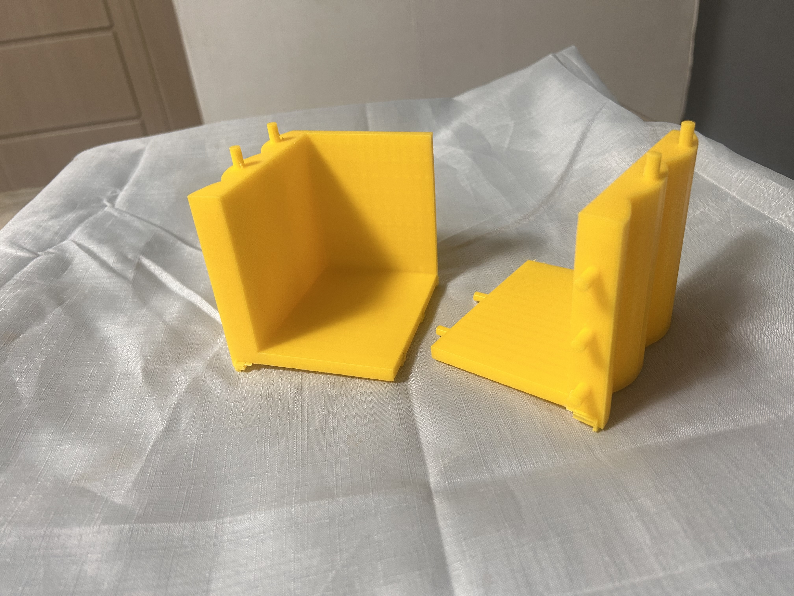
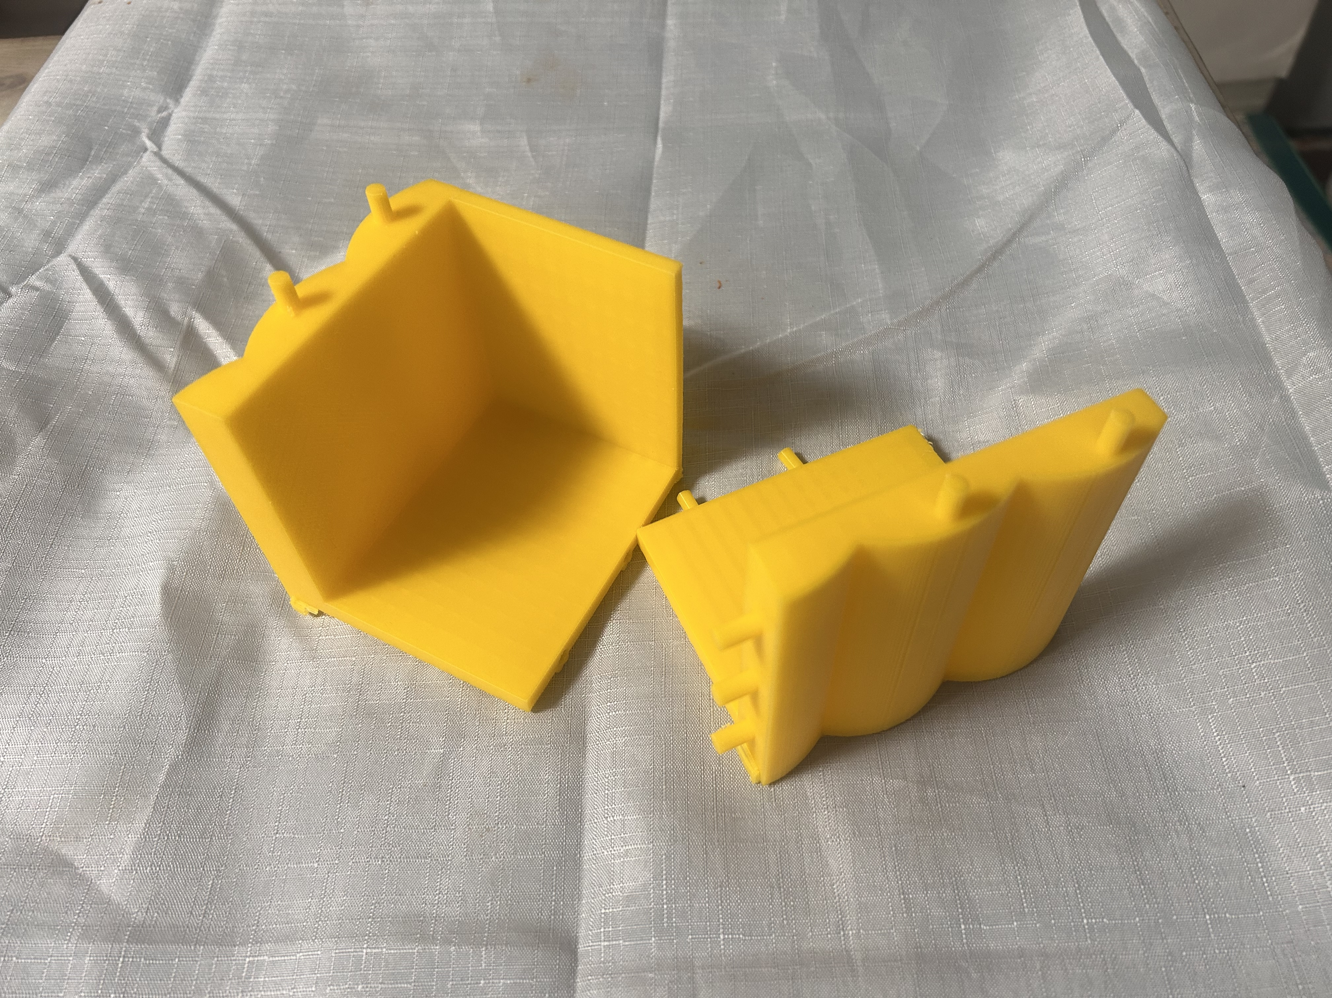
3D Model

Slide 16
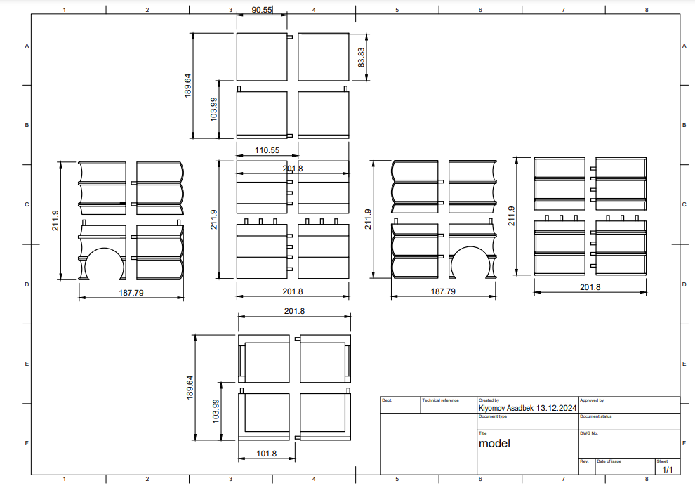
Sketch

Slide 17
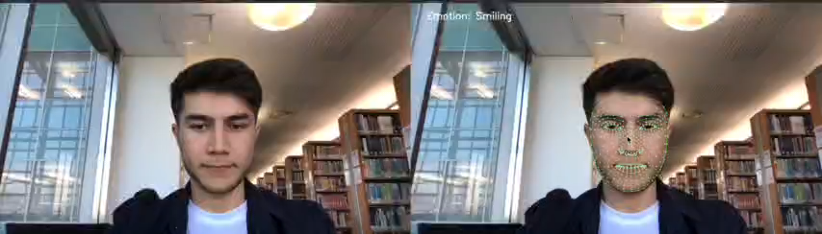
Video Demo
Facial Expression Demo Video
Based on your emotion RoboLib recommend appropriate books

Slide 18
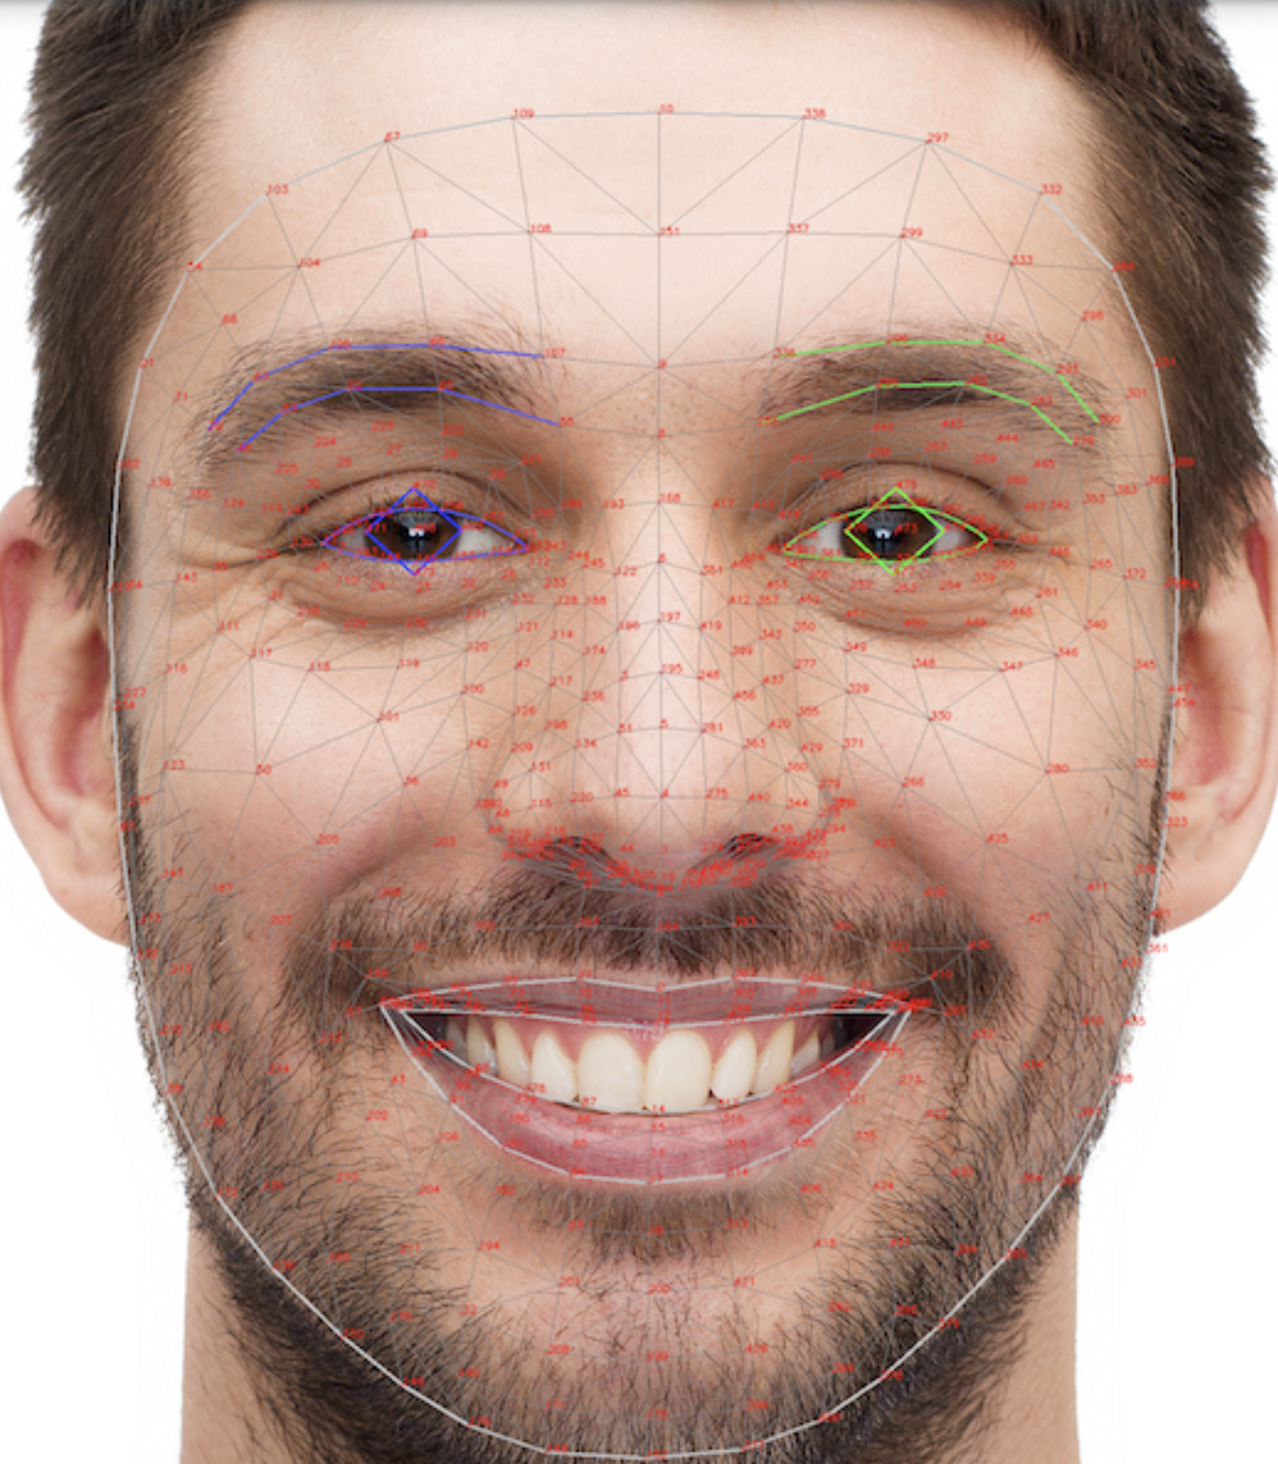
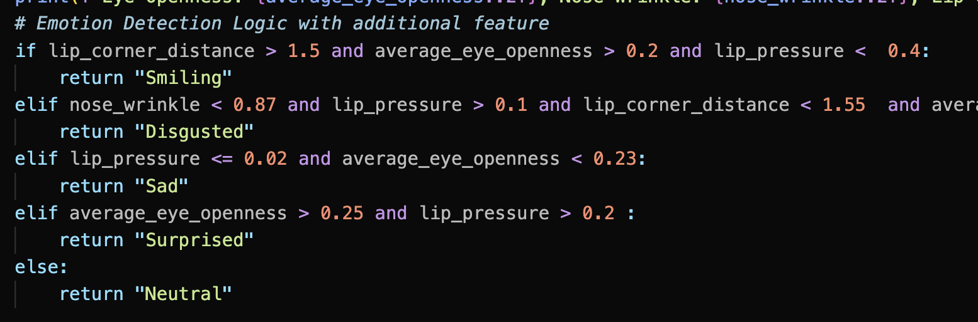
Algorithm for face emotion
There are 478 landmarks for Face

Slide 19
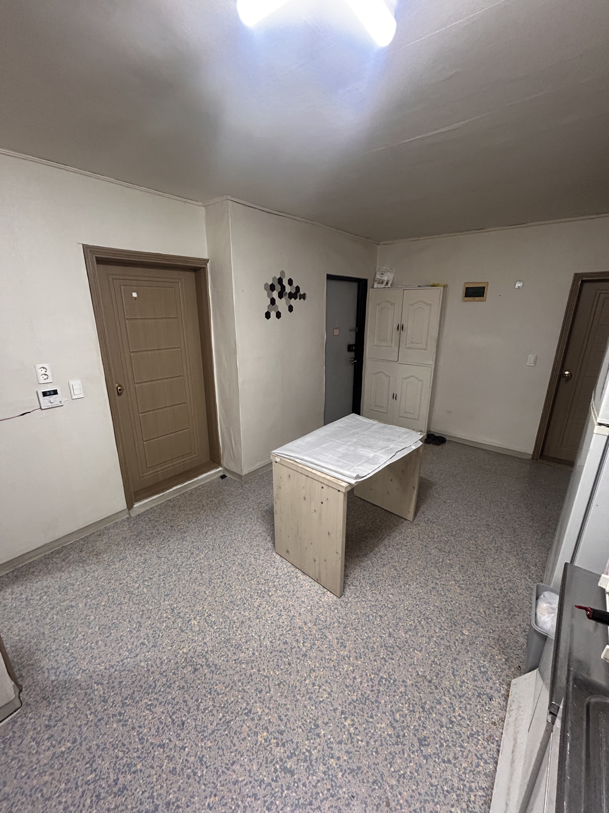
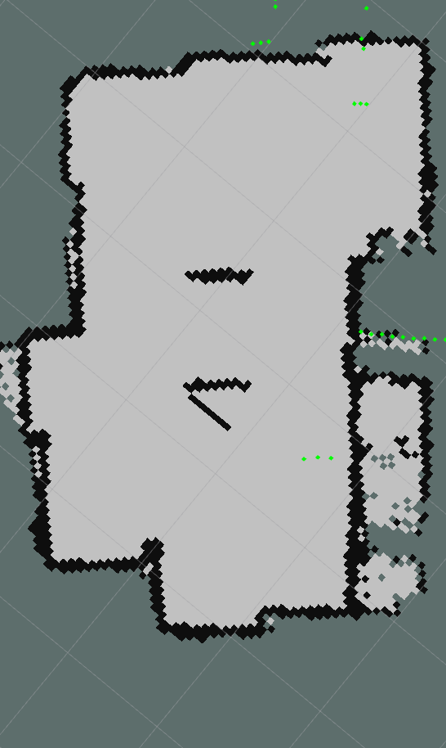
Slam G Mapping

Slide 20
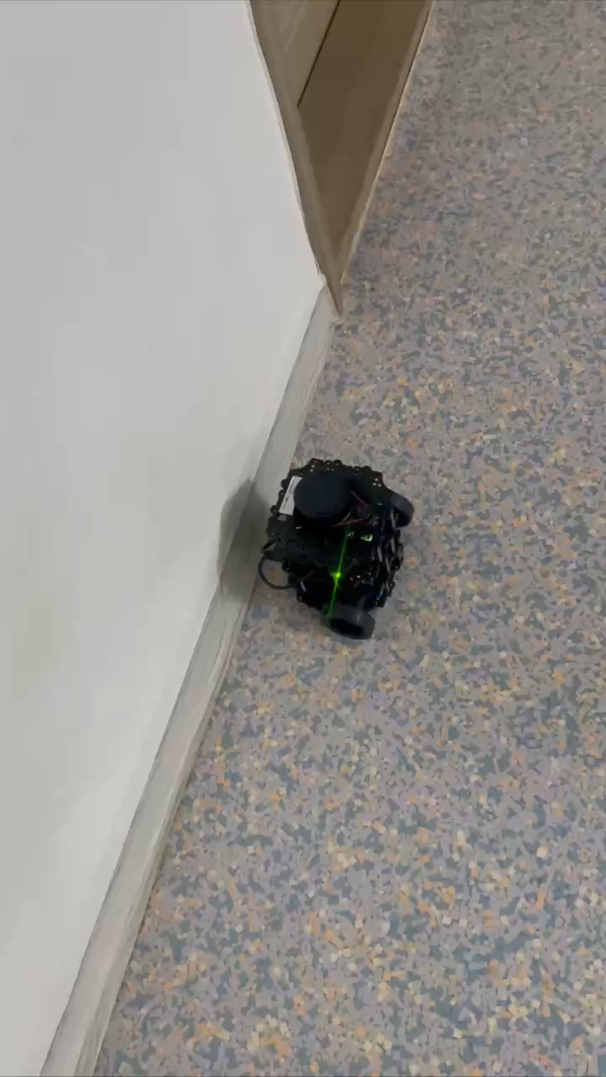
Slam G Mapping

Slide 21
Benefits
For Users:
Faster book search.
Easy navigation.
Quick responses to queries.
For Staff:
Reduced workload.
Efficient inventory management.
Focus on value-added tasks.
For Libraries:
Improved operational efficiency.
Enhanced user satisfaction.
Modernized services.

Slide 22
Conclusion
RoboLib is a cutting-edge solution for libraries aiming to:
Enhance user experience.
Improve operational efficiency.
Automate repetitive tasks, empowering staff to focus on strategic objectives.

Slide 23
References
https://emanual.robotis.com/docs/en/platform/turtlebot3/quick-start/
https://ai.google.dev/edge/mediapipe/solutions/vision/face_landmarker

Slide 24
Q&A
THANK YOU FOR YOUR ATTENTION
Feel free if you have a questions

